Slide 1
Hospital Review
2024
BIBIN LOUIS

Slide 2
Specifics
The analysis focuses on remuneration of doctors and staff, profit margins of the hospital, usage of medical equipment and resources, key influencers like government policies and insurance companies, and reviews and feedback from patients on services, treatment outcomes and experience. It helps hospitals understand strengths, weaknesses and scope for improvements from both financial and patient care perspectives.
2024
Defining purpose and focus of the analysis.

Slide 3
Data Collection
2024
Focus on data integrity and entanglement of understanding data.

Slide 4
Data Perspective
2024
Key Takeaways
Counter Arguments
The data provided seems to be hospital-related statistics, possibly related to different medical centers and their associated attributes such as type, performance, and financial data.
The dataset includes information about various hospitals, including their type (church-related, not-for-profit corporation, for-profit corporation, etc.), number of beds, patient statistics, and financial data.
Hospitals are categorized based on their ownership and operational parameters, providing a comprehensive overview of the healthcare landscape in the region.
This data can be used for analysis and comparison of hospitals in terms of size, ownership, and financial performance.
Limitation regarding data.
Without further context or specific research questions, the raw data may need to be curated and analyzed to derive meaningful insights.
The dataset lacks contextual information such as geographical location, patient outcomes, and specific medical services offered by each hospital, which limits the depth of analysis.

Slide 5
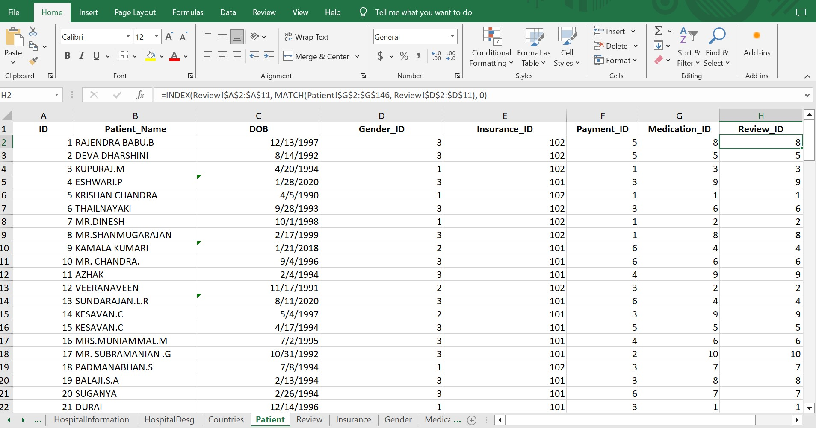
Excel Data Handling
2024
Implementation regarding data involves cleaning and implementing separation of concerns.
Using excel formulas like “INDEX” to provide context and relationship.

Slide 6
Establishing Relationship
2024
Focus on defining relationship to strengthen the idea of analysis.

Slide 7
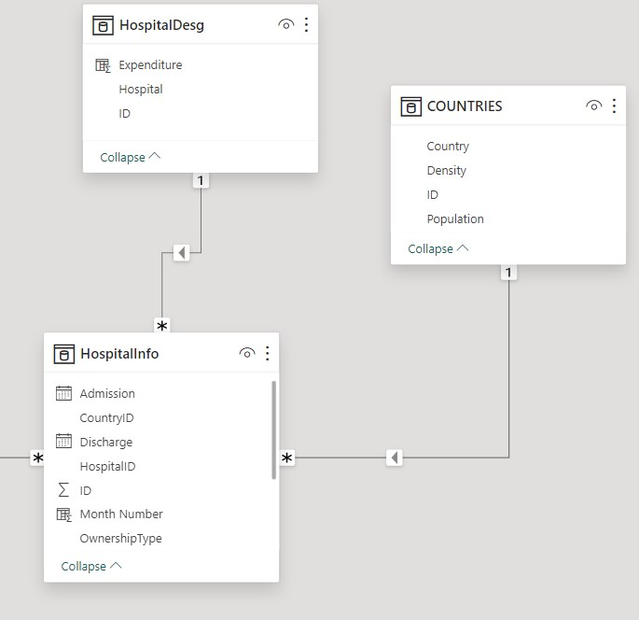
Hospital Generic Relationship
2024
The Relationship describes about the Hospital Interactions
The data illustrates a one-to-many relationship to Designation and Countries.
Hospital info serves as master data, detailing key features like admission, discharge, and Ownership Type.
Factual implementation hinges on details linked to Hospital Info, with foreign keys like HospitalID and CountryID.

Slide 8
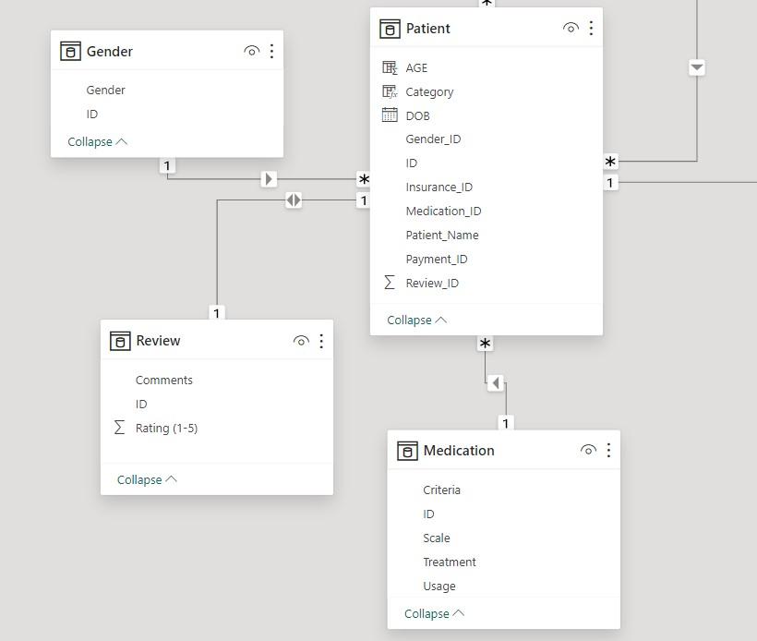
Patient Generic Relationship
2024
The Relationship describes about the Patient Interactions
The data depicts a one-to-many relationship to Gender, Review, and Medication.
Patient data serves as master data, detailing key features including Patient Name, Category, and Age.
Implementation relies on details linked to the Patient, with foreign keys like Medication_ID, Gender_ID, and Review_ID.

Slide 9
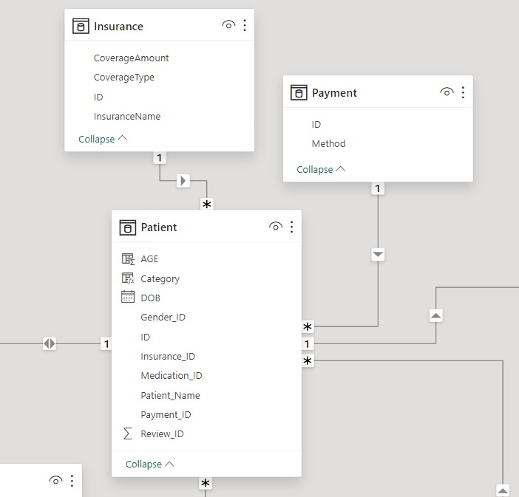
Patient Secondary Relationship
2024
The Relationship describes about the secondary patients attributes
The data explains about the one to many relationship to Insurance and Payment.
The factual implementation relies on the details connected with Patient, which stimulates a foreign key that is dependent to the Patient such as Insurance_ID and Payment_ID.

Slide 10
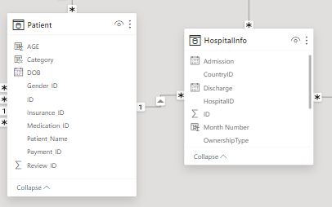
Indulging Relationship
2024
The Relationship describes about the outbound patients attributes
The data explains about the one to many relationship with Hospital Info and Patient.
The factual implementation relies on the details connected with Patient, which stimulates a foreign key that is dependent to the Patient such as Payment_ID and Insurance_ID.

Slide 11
Calculations
2024
Focus on deriving performance oriented parameters.

Slide 12
Interpretation of Averages
2024
The data explains the understanding with calculation:
Average Rating = AVERAGE(Review[Rating (1-5)]). The code calculates the average rating by finding the average of the "Rating (1-5)" column in the "Review" data table.
Average Renumeration = CALCULATE(AVERAGE(HospitalInfo[Renumeration])) This code uses DAX to calculate the average renumeration by applying the AVERAGE function to the "Renumeration" column in the "HospitalInfo" table, with the CALCULATE function providing context for the calculation .
AveragePerTenure = AVERAGEX(VALUES(HospitalInfo[TotTenure]), CALCULATE(AVERAGE(Review[Rating (1-5)]))). This DAX code calculates the average rating per tenure by iterating through unique values of "TotTenure" in the "HospitalInfo" table and applying the average of "Rating (1-5)" from the "Review" table for each tenure value.

Slide 13
Interpretation of Variables
2024
The data explains the understanding with calculation:
Mean Renumeration = GEOMEAN(HospitalInfo[Renumeration]). The GEOMEAN function is used to calculate the geometric mean of the "Renumeration" values within the "HospitalInfo" table.
Patient Count = COUNT(HospitalInfo[PatientID]). The Patient Count is calculated by counting the occurrences of PatientID within the HospitalInfo table, providing the total number of patients in the dataset.
ProfitMargin = CALCULATE(SUM(HospitalInfo[Renumeration]) - SUM(HospitalDesg[Expenditure])), The ProfitMargin is calculated by subtracting the total Expenditure from the total Renumeration, using the CALCULATE function to handle the context transition for the calculation.

Slide 14
Calculated Columns
2024
The data explains the understanding with calculation:
Quarter = ROUNDUP(HospitalInfo[Month Number]/3, 0). The Quarter is determined by dividing the Month Number by 3, then rounding up to the nearest whole number using the ROUNDUP function. This calculation assigns each month to its corresponding quarter.
Renumeration = [TotTenure] * [PerDayCharge]. The Renumeration is derived by multiplying the TotTenure (total tenure) by the PerDayCharge, indicating that the overall renumeration is based on the total tenure and the daily charge.
TotTenure = HospitalInfo[Discharge] - HospitalInfo[Admission]. The TotTenure is calculated by subtracting the Admission date from the Discharge date, providing the total duration of a patient's tenure at the hospital.
Month Number = (12 * Year(HospitalInfo[Discharge]) + Month(HospitalInfo[Discharge])) - (12 * Year(Date(2023, 12, 1)) + Month(Date(2023, 12, 1))) + 82. This calculates the month number by mitigation a reference point such that it would have a series starting from 1.

Slide 15
Analysis on Data
2024
Focus on data abbreviations with Analysis.

Slide 16
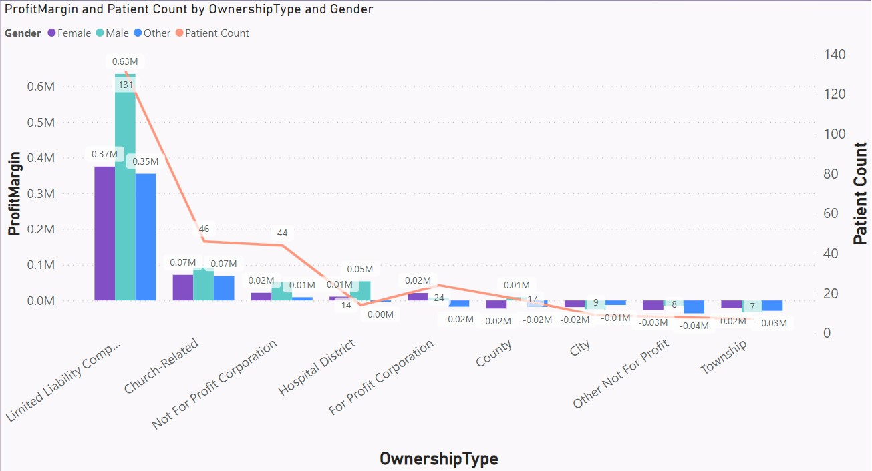
Profit Margin and Patient Count by Ownership Type
2024
Profit Margin with respect to Ownership Type
Profit Margin
The chart depicts an L-shaped curve correlating ownership type and profit margin and highlights gender-based customer contributions.
Men are the primary customers, contributing up to 0.63 million profit margin in Limited Liability Companies, declining over time.
Women and other communities are secondary customers, contributing 0.37 and 0.35 million profit margin respectively, with similar declining trends.
The analysis suggests investing more in Limited Liability Companies for higher profit margins.

Slide 17
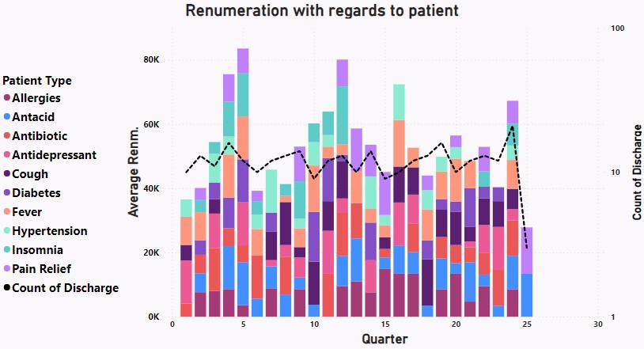
Renumeration with regards to patient
2024
Renumeration with respect to patient type.
Renumeration doubles in the 5th quarter, reaching 60k from 40k, correlating with stable discharge counts of 10 to 14.
Antidepressant coverage starts at 13k Euros in Q1, decreases to 6k in Q9, while diabetes scales up by 244% in Q10.
Insomnia sees a 147.85% increase in Q5, then decreases to 14% before rising to 57%. Common cold shows a 197% increase.
Antibiotic use rises by 87.6%, raising concerns about excessive use, while antidepressant decreases by 66% in Q12.
Antacid use surges by 274% from Q15 to 25, fever cases increase by 139%, and pain relief escalates by 221% from Q17 to 25.
Allergies decrease by 42.36% in Q24, while fever sees a 127% increase, impacting renumeration despite decreasing discharge counts.
The data analysis reveals significant trends in renumeration and medication usage over different quarters. Renumeration spikes in the 5th quarter, correlated with consistent discharge counts. Medication use fluctuates, with notable changes in antidepressant, diabetes, insomnia, common cold, antibiotics, antacid, fever, pain relief, and allergies, showing varying impacts on hospital renumeration. These insights highlight the complex interplay between treatment patterns, patient conditions, and financial.

Slide 18
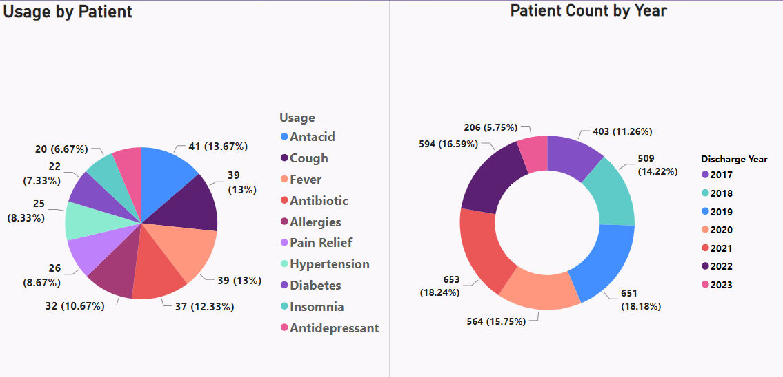
Usage and Statistics
2024
The major usage for patient check-ups includes antacid, cough, fever, antibiotic, and allergies, constituting 13.67%, 13%, 12.33%, 10.67% and 8.67%, 8.33%, 7.33%, and 6.77% for pain relief, hypertension, diabetes, insomnia, and antidepressant.
Patient count provides insights into population health trends, with major contributions in 2018 (14.22%), 2019 (18.18%), 2020 (15.75%), and 2021 (18.24%), followed by a dip in 2022 (16.96%) and 2023 (5.75%).
Indicates evolving population health patterns in recent years. Moreover, Antacid, cough fever are most commonly seen medications been provided thus it is clearly indicating that we should have ample amount of experts to tackle it across the population.

Slide 19
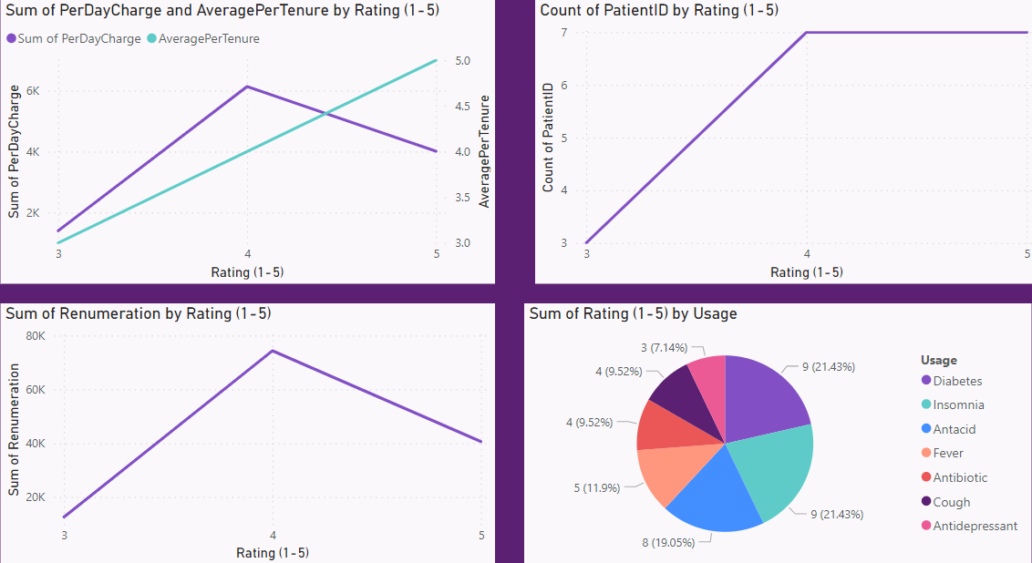
Key Influencers
2024
The Per day charge increases by 200% with rating, but then declines by 33.33%, revealing an inverse relationship, likely indicating service-oriented remarks.
Average Per Tenure rises proportionally with rating, suggesting a positive correlation between tenure and patient satisfaction.
Hospitals admitting more patients receive higher ratings, reflecting a positive patient experience leading to higher ratings.
Diabetes, Insomnia, and Antacid treatments are associated with higher standard ratings (21.43%, 21.43%, and 19.05%), while Fever, Antibiotics, Cough, and Antidepressant receive lower ratings (7% to 11%).

Slide 20
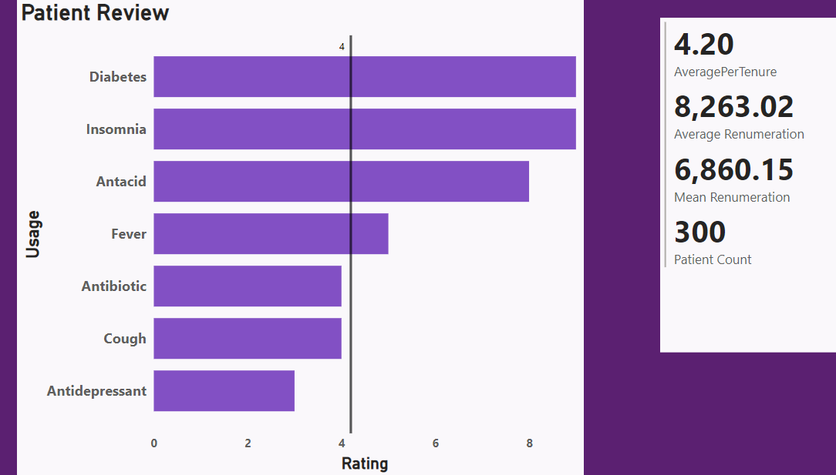
Patient Dynamics
2024
Patient reviews indicate an average rating of 4, with exceptional ratings near 8-8.5 for patients with diabetes, insomnia, antacid, and fever, reflecting outstanding service and professionalism. Other patients, especially those with fever, antibiotic, cough, and antidepressant, received ratings at or below the average.
The average renumeration for the hospital is approximately 8,263.02 Euros, providing an overview of the financial outlook, with a mean around 6,860.15 Euros. The patient review statistics are based on approximately 300 patients.

Slide 21
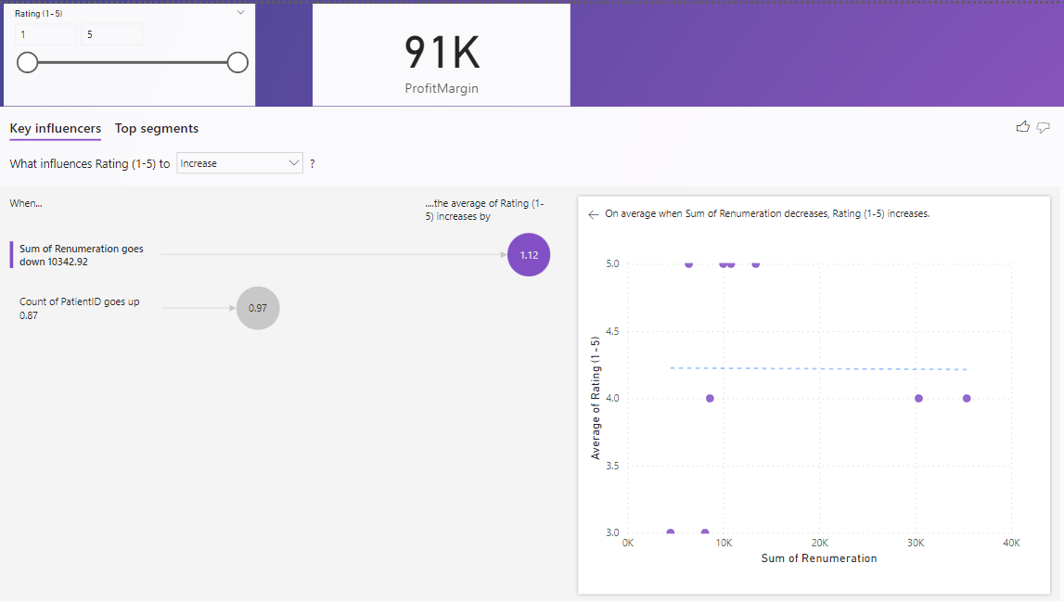
Automated Segments
2024
It shows the renumeration goes down by 10342.92.
Count of patients goes up to 0.97%.
As the sum of renumeration decreases the rating increases as does the count of patients.

Slide 22






Analysis Overview
2024
Profit
Renumeration
Usage
Limited Liability Companies provide higher margins for profit.
Complexity in interplay. Medications fluctuates a lot.
Evolving health patterns in recent years. Ample amount of experts to tackle antacid, cough and cold.
Key Influencers
Patient Dynamics
Automated Segments
More patients provide better rating. Furthermore, Diabetes, Insomnia and antacid treatments are having higher rating.
Average Renumeration comes around 8000 Euros. Antidepressant, Antibiotic and Cough are having below average ratings overall.
As the sum of renumeration decreases the rating increases as does the count of patients.

Slide 23
THANK YOU!
2024
VIEWERS

